Slide 1
POZYX WORKSHOP
Presented by:
Paul Hammond
Professor Stefan Greuter
Deakin University - SCCA

Slide 2
Aims of this workshop
POZYX
- What is it?
- How does it work?
Our Project
- What is it?
- How does it work?
- Demonstration
Future Projects
- Discussion & Brainstorming

Slide 3
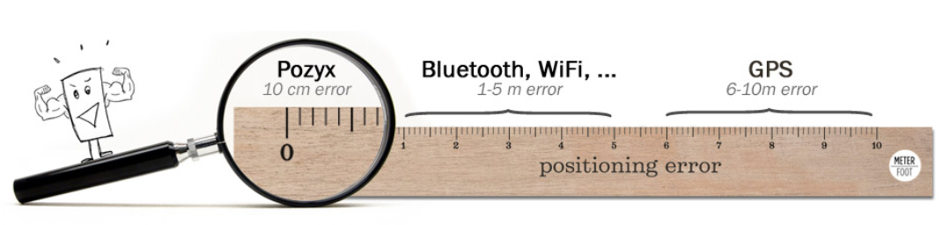
Pozyx – what is it?
Pozyx:
Hardware localisation system
provides centimetre-accurate positioning and motion information in three-dimensional (3-D) space.

Slide 4
Pozyx – what is it?
Pozyx:
Utilises ultra-wideband (UWB) wireless radio technology
Suitable for Indoor and Outdoor use
No interference with other RF systems (Wi-Fi, TV, Radio, Bluetooth)
Range:
Around 30 metres (typical indoor applications)
Up to 100 metres (with clear line of sight)
Signals can pass through 1 to 2 walls

Slide 5
Pozyx – what is it?
Pozyx Hardware:
Anchors
Tag(s)
Anchors and Tags measure UWB signal propagation delays
Ie. How long a signal takes to travel from a sender to a receiver
Measured in nanoseconds (1 billionth of a second)
Results in centimetre-accurate positioning

Slide 6
Pozyx – what is it?
ANCHORS
Placed in known, fixed locations
User-defined locations (x, y, z)
Act as reference points
enable a Tag to determine its position
and motion relative to these points
2-D positioning
3 Anchors required
3-D positioning
4+ Anchors required

Slide 7
Pozyx – what is it?
TAG(S)
The module(s) we want to track…
Any person or object wearing a tag can be located!
Incorporate:
3-axis accelerometer
3-axis gyroscope
3-axis compass
Pressure sensor
Multiple Tags can be used within the Pozyx system
We have 5 available in our kit
Tags can also be used as additional Anchors
Just remove a jumper on the board
Arduino and Raspberry Pi compatible

Slide 8
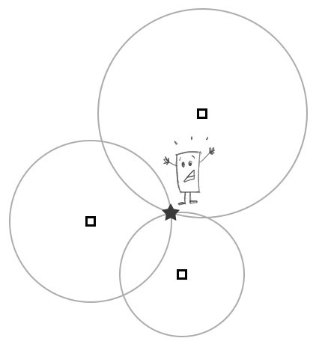
Pozyx – HoW DOES IT WORK?
TRILATERATION
Uses basic geometry to obtain the Tag’s position
By measuring the distance to a number of Anchors (each with a known position) and finding the intersecting point
Distance = Speed of UWB signal * Time to reach module
The most commonly used method of positioning
Eg: Global Positioning System (GPS)
Satellites = Anchors
Tag = Your car / phone, etc
Remember:
2-D positioning
3 Anchors required (see picture opposite)
3-D positioning
4+ Anchors required
> 4 = greater accuracy

Slide 9
Our project – what is it?
Our project involves:
Extracting position data (x, y, z) and orientation data (pitch, roll, yaw) from a Pozyx Tag(s)
Streaming that data into a virtual environment (in real-time)
Unity3D
This lets us physically enter a virtual environment!

Slide 10
Our project – what is it?
Entering a virtual environment:
Our current physical location, orientation and movement is accurately captured by the Pozyx system and mirrored as a Game Object in Unity
Moving to a particular location, or making a specific gesture, in the physical world can trigger unique responses in the virtual one.
So, we are able to fully interact with that virtual environment through the utilisation of Unity’s inherent systems, such as object collision detection.

Slide 11
Our project – HOW IT WORKS?
Software Application:
We’ve developed a Python-based application that:
Establishes communication with the active Pozyx Anchors and Tag(s)
Collects positioning (x, y, z) and orientation (pitch, roll, yaw) data, from the Pozyx system, in real-time
Converts that data into OSC packets and outwardly streams the packets via the OSC protocol
OSC = Open Sound Control, a lightweight networking protocol
Other applications, such as Unity, can receive OSC packets and extract the position and orientation data
In Unity, this data can be used to control / manipulate a Game Object

Slide 12
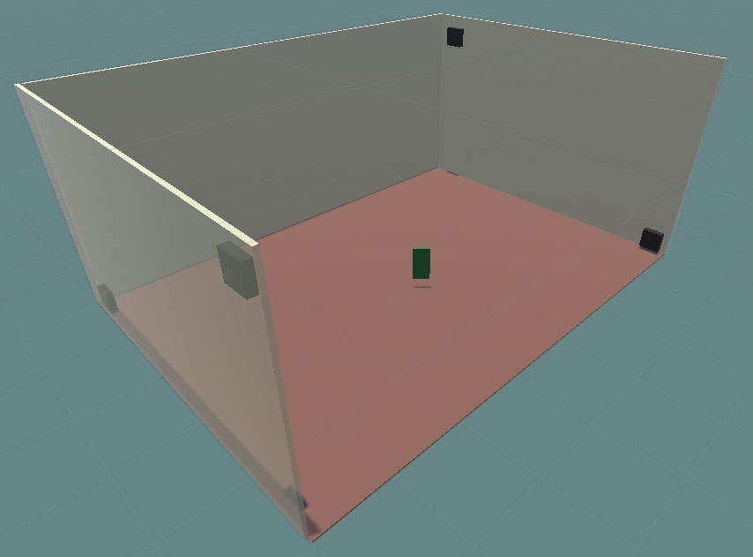
Our project – HOW IT WORKS?

Slide 13
Our project – DEMONSTRATION
We will now commence a demonstration of our project…

Slide 14
Future Projects
We feel this system offers countless opportunities for exciting research / project applications and would now encourage you to engage in a brainstorming discussion to share ideas…
We’ll begin by showing some video demonstrations…

Slide 15

VIDEO DEMONSTRATION #1

Slide 16
VIDEO DEMONSTRATION #2

Slide 17
VIDEO DEMONSTRATION #3

